Slide 1
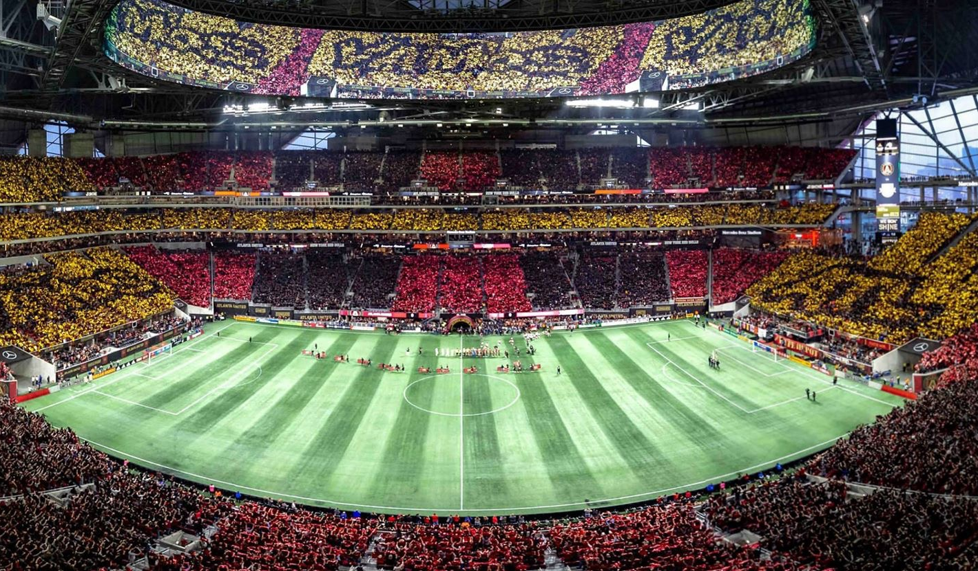
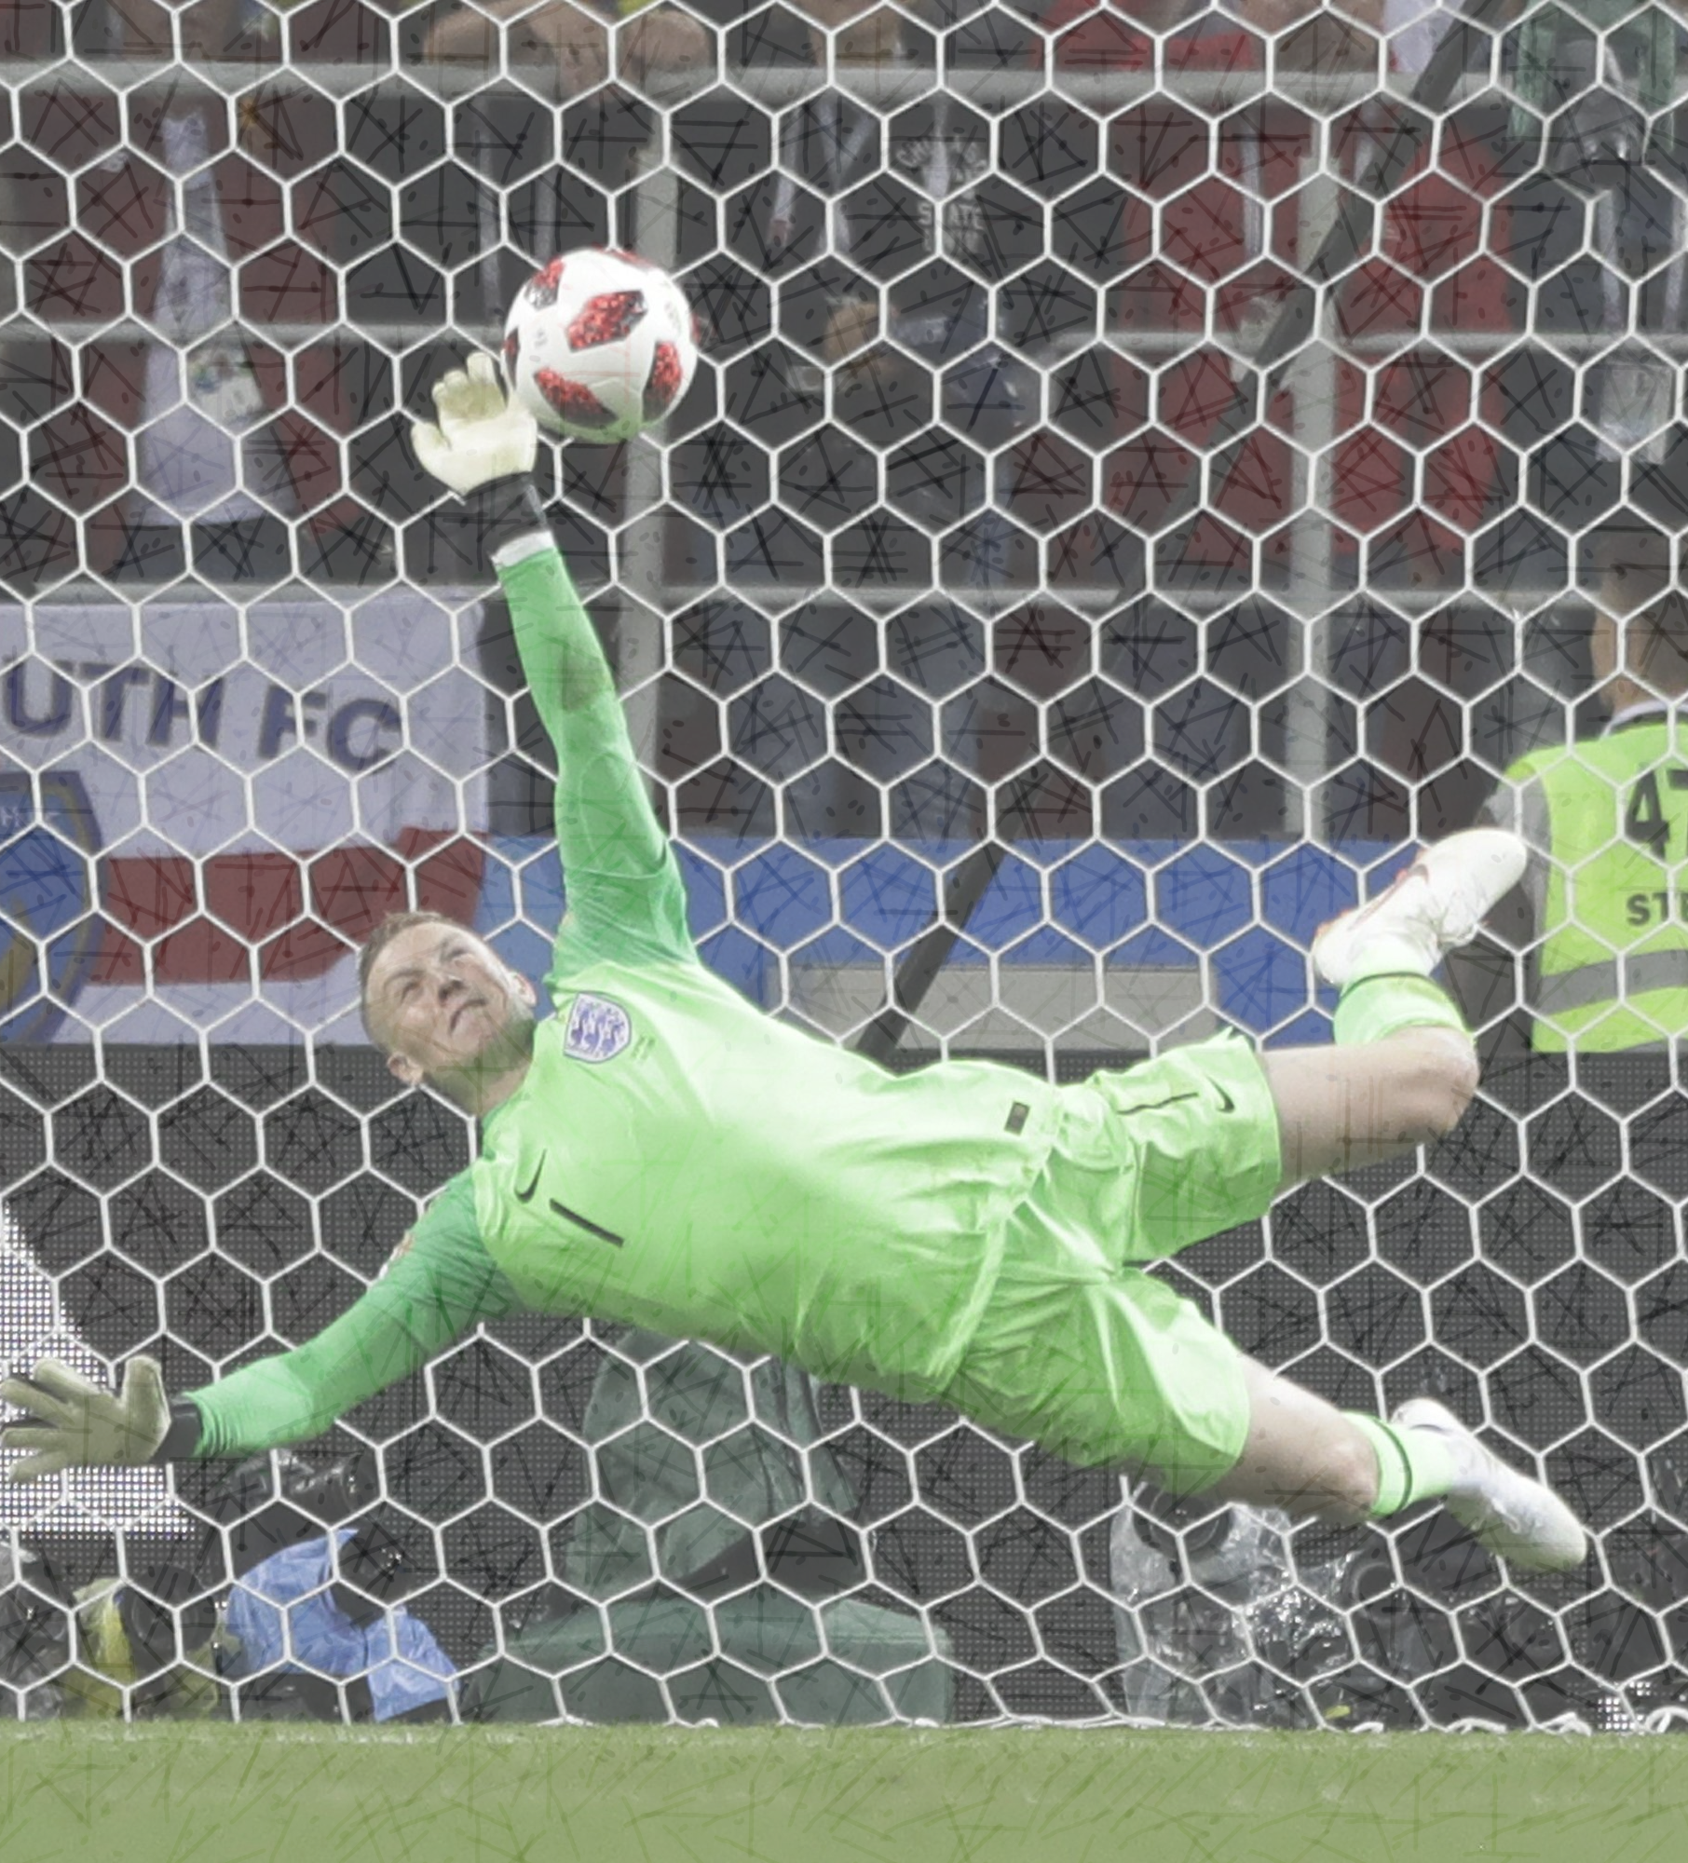
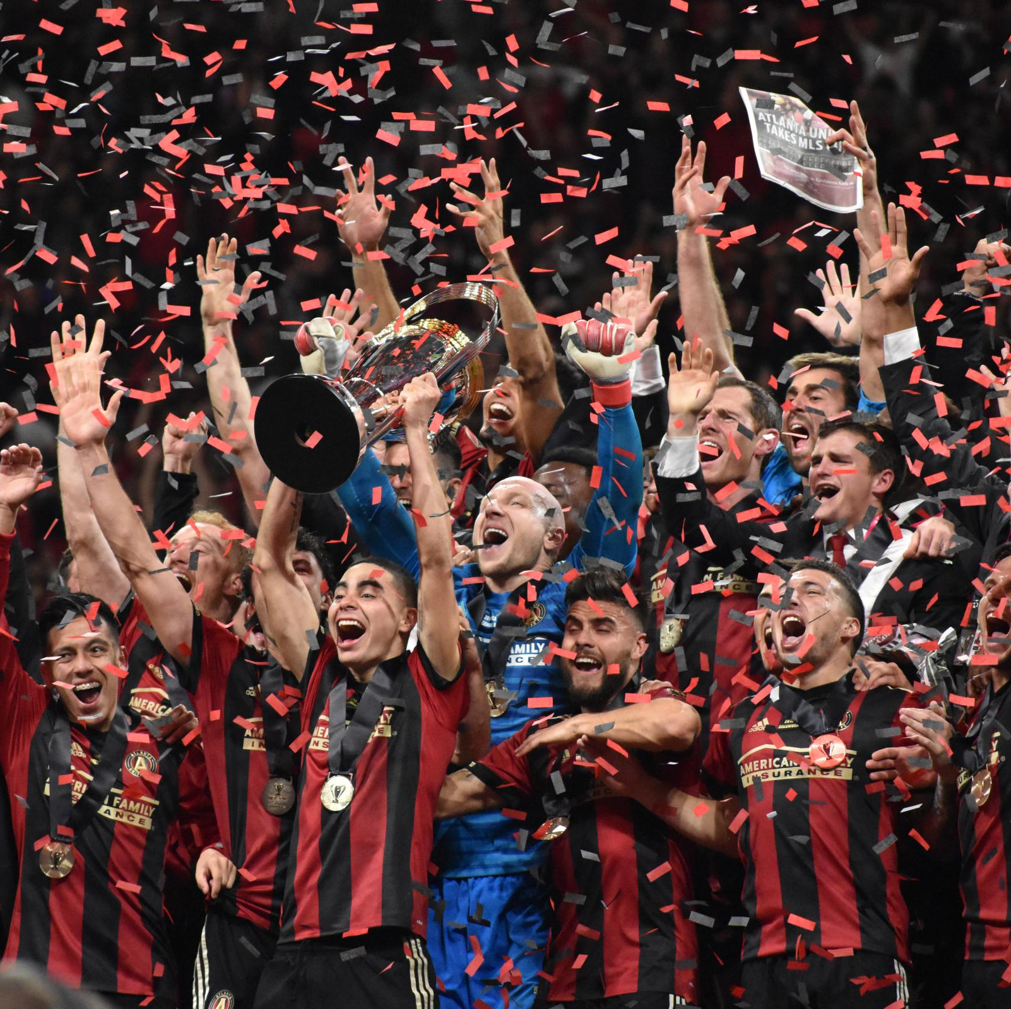

Atlanta United 2018 Championship season
How the 2018 season became a dream season for Atlanta and a fun penalty shoot out to remember the season.
https://github.com/ksu-is/AtlantaUnited
Coded by Bruno Cubas Garcia with help of Github repositories by Shivam010 and Danlitwak

